Slide 1
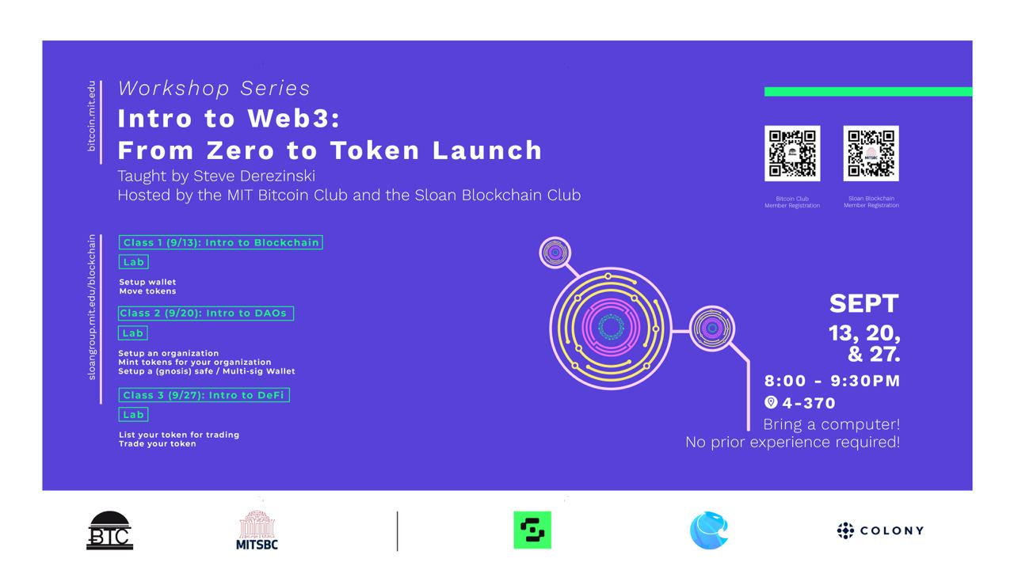

Slide 2
Pre-class
If you have not made a wallet, go to:
metamask.io install browser extension
Post your Ethereum wallet to Whatsapp group.
Will try to get you some Rinkeby ETH.
If you have not made an organization, go to:
Client.aragon.org – CONNECTED TO RINKEBY network
Make your company / token. (ask a friend to show you)

Slide 3
Intro to Web3
Class 3: Launch a Token – Intro to DeFi

Slide 4
Disclaimer
Content is for educational purposes only

Slide 5
About me
Education
MIT Undergrad in Mech Eng (robotics)
MBA MIT Sloan Fellow in Global Leadership and Technology Innovation
Crypto/Blockchain Work:
Founder of Hashchat.xyz – web3 messaging
Developed tokenomics framework for crypto startup
Taught Blockchain Ventures at MIT Media Lab
Consulting with Large Multinational organizations on Blockchain Implementations

Slide 6
Course Review
Class 1: Wallets
Establish a unique address in Web3.
Catch up: go to metamask.io install browser extension
Post your Ethereum wallet to Whatsapp group.
Class 2: Building a DAO or “Crypto Board of Directors”
Build a Gnosis Safe (hold digital assets with a group)
Set voting parameters of Aragon DAO
Class 3: Launch a Token -- tonight

Slide 7
Key concepts in Innovation: Incremental and Architectural
Incremental Innovation
Advantage: incumbent
Leverage: Lower costs
Architectural Innovation
Advantage: New Venture
Leverage: Decentralization of system & authority

Slide 8
Examples
Confirmed asset transfers anywhere on the globe with zero trusted intermediary?
=> Basically all L1s.
Decentralized brokerage?
=> Let’s look…

Slide 9
Central vs. Decentralized Marketplaces
Central Market
Concentration of buyers / sellers
High liquidity
High volume
Good price discovery
Best deals
Market makers
Maintain order book
Decentralized Market
Who provides liquidity?
Who will be the market maker?

Slide 10
Uniswap (Nov 2018)
Launched the first Decentralized Exchange (DEX)
Open-source, public good
All smart contracts are open-source
How does it solve Liquidity and Market Making?

Slide 11
Uniswap -- Liquidity
Trading Pairs, ETH / DAI for example.
Anyone can provide capital to the liquidity pools in 50-50 equal value pairs.
Today: 1 ETH / 1350 DAI (note: error fixed, but should be 50-50 value in USD)
Each trade generates Liquidity provider fee 0.3%, added to pool.

Slide 12
Uniswap -- AMM
Automatic Market Maker:
Constant Product Formula
X * Y = K
X = Number of X tokens in pool
Y = Number of Y tokens in pool

Slide 13
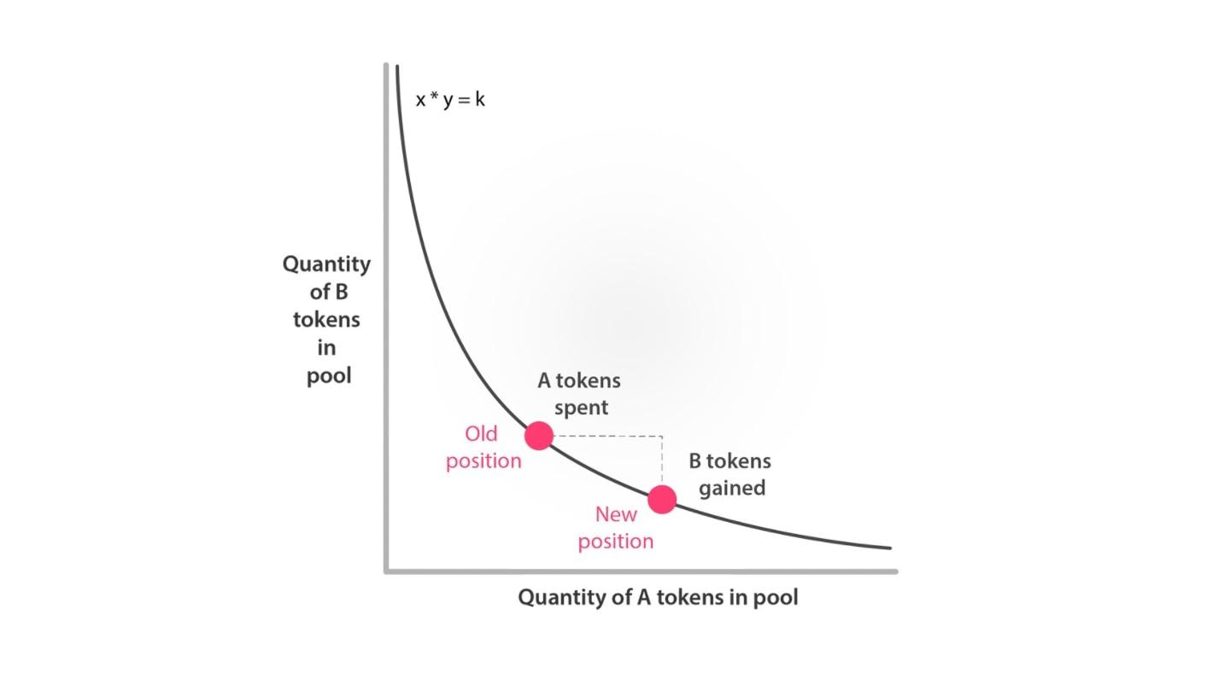
Uniswap’s AMM curve
QTY of OMG in token pool
ETH spent
OMG Tokens gained by buyer
QTY of ETH in token pool
Price token OMG = Qty token ETH / Qty token OMG
Source: Curve Research

Slide 14
Example Trade (using 0.25% fee)
10 ETH and 500 OMG tokens deposited into LP position
ETH_pool = 10 ETH OMG_pool = 500 OMG k (invariant) = 5000
Buyer sends: 1ETH for OMG tokens
ETH_Pool = 10 + 1 – 0.0025 (fee) = 10.9975 ETH
OMG_pool = k / ETH_pool = 5000 / 10.9974 = 454.65
Buyer receives 500-454.65 = 45.35 OMG tokens
Fee is added to ETH_pool 10.9975 + 0.0025 = 11
OMG_pool is 454.65 OMG
New Invariant = 11 * 454.65 = 5001.15
Reference: https://docs.uniswap.org/protocol/V1/introduction

Slide 15
Uniswap today
V1, v2, v3
~$4B in TVL (total value locked)
~$7B in trades over 24hrs
Largest pools:
DAI / USDC: $1B
BTC / ETH: $200M

Slide 16
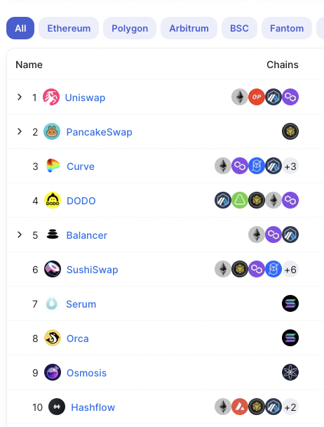
Success and Open source means forks!
Uniswap forks:
PancakeSwap (binance)
Curve (ETH)
Balancer (ETH)
Sushiswap (ETH+)
List: https://defillama.com/dexs

Slide 17
Token launch and trading
Provide liquidity for your token
Choose the trading pairs
Typically XYZ / ETH
From the wallet that has the tokens from Aragon
But first, we need the ERC20 contract created.

Slide 18
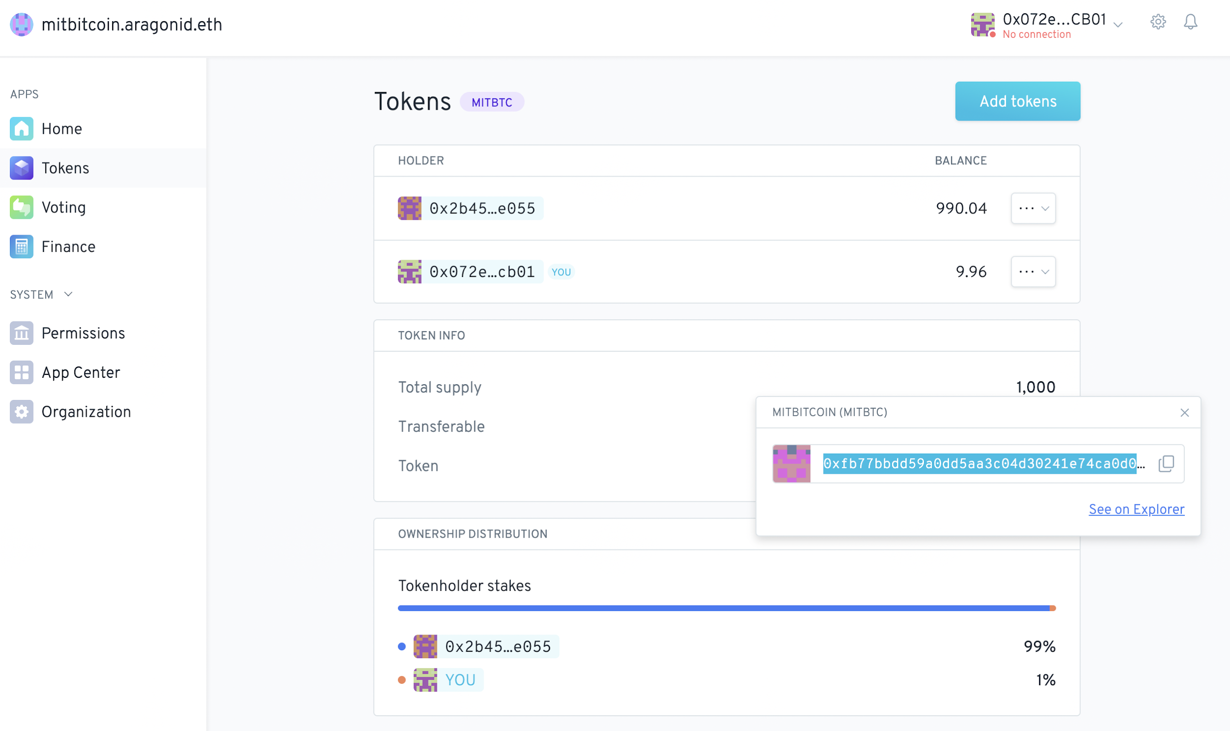
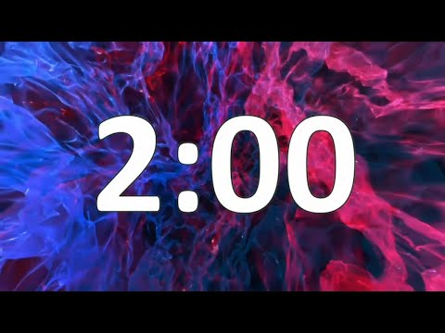
GOTO: https://client.aragon.org/

Slide 19
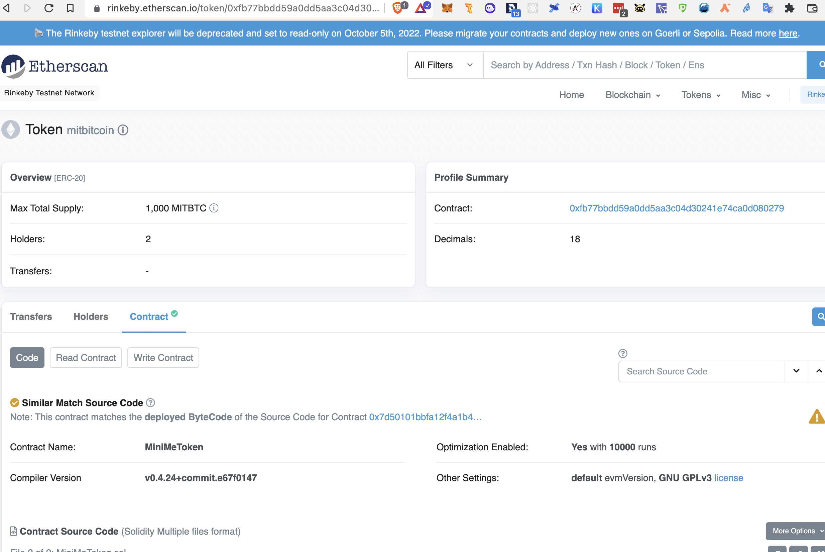

Slide 20
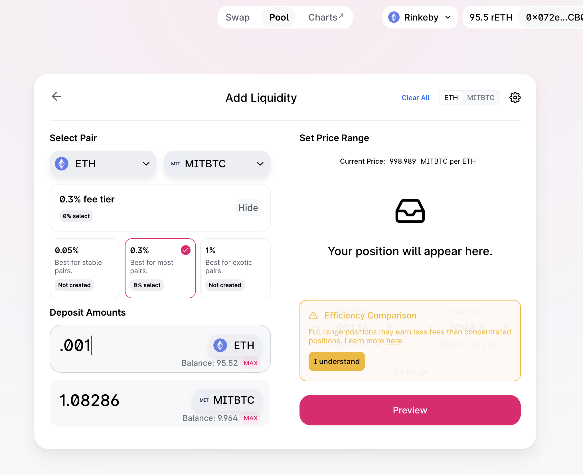
GOTO: https://app.uniswap.org

Slide 21
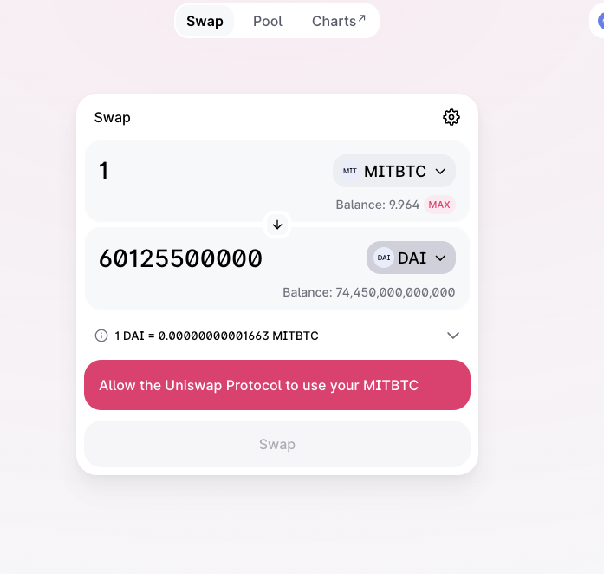
Trade your token!

Slide 22
Areas to explore
Beyond Uniswap
DeFi Landscapes
Balancer.io
Curve.fi
1inch
Aggregators:
1inch
paraswap
Matcha.xyz
DefiLlama.com
https://www.defipulse.com/

Slide 23
Congratulations!
sjd@mit.edu
@sjdthree1
tg: @sjdthree
try our app www.hashchat.xyz !!!!
No crypto needed!

Slide 24
